Slide 1

Please follow Presentation Instructions:
Slide 1: Cover
Project Title: [Insert Project Title]
Presenter's Name: [Your Name]
Date: [Date of Presentation]
Slide 2: Project Idea
Brief description of the problem being solved
Overview of the proposed solution (high-level idea)
Unique value proposition (Explain what makes your project stand out)
Slide3: Project Wireframe
Visual representation of key user interfaces (e.g., homepage, dashboard)
Overview of user journey (from onboarding to core features) | *Note: for software groups only
Focus on usability and user experience

Slide 2
Please follow Presentation Instructions:
Slide 4: End Users + Features
Define primary user personas (e.g., individuals, businesses, etc.)
Key features that address user needs (list the most critical functionalities)
Explain how the features solve the problems of each end-user
Slide 5: Data Structure
Description of the database architecture (e.g., relational, non-relational)
Key entities and relationships between data points
Data flow (how data is collected, stored, and accessed). *Note: If you used CSV file, describe the features, the shape of data, balanced or not, used techniques, etc..
Final 6: Programming Languages + Frameworks
List the main programming languages used (e.g., Python, JavaScript)
Highlight frameworks/tools used (e.g., Django, React)
Mention any supporting technologies (e.g., APIs, cloud platforms)

Slide 3
Please follow Presentation Instructions:
Slide 7: Live Application + Test
Overview of the current state of the live application (beta/production)
Key testing phases (unit testing, integration testing, user testing)
Feedback from users or quality assurance
Slide 8: Deliverables (Reports, etc.)
List of reports and documentation to be provided (e.g., technical specs, user manuals)
Timeline for deliverables (milestones and deadlines)
Other final products (e.g., working app, source code repository)
Slide 9: Project Team + Roles
List the core team members and their roles (e.g., developers, UX designers)
Key responsibilities for each team member
Collaboration methods (e.g., communication tools, agile methodologies)

Slide 4
Please follow Presentation Instructions:
Slide 10: Thank You
Contact information for follow-up
Invitation for questions or feedback

Slide 5

MANDATORY Color Scheme
Note: This is the official
color scheme for DEPI
Feel free To use it
#047954
#0FAB7D
#336EA8
#D7B119

Slide 6
SafeGuard Ag
AI-Powered Crop Yield Prediction System
Shahd Mostafa
Leader AI-Engineer
July 2026
Safe Guard Ag Project

Slide 7


Project Vision
The Problem
Farmers currently rely on traditional guesswork and intuition for crop cycles. This leads to massive crop losses, resource waste, and chronic food insecurity in vulnerable regions.
The AI Solution
Predicts crop yield with 94.27% accuracy. Features unique XGBoost noise detection, real-time drift monitoring, and a user-friendly web interface for actionable insights.

Slide 8
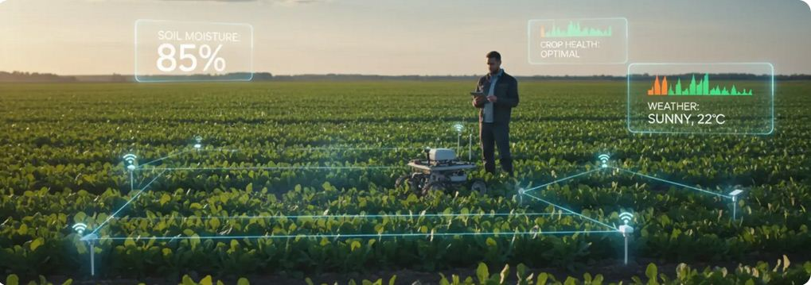
Seamless Experience Fill Form: Input environmental data (Soil, Weather, etc.). Predict: AI Model processes inputs in real-time. View Result: Get immediate yield prediction scores. Designed for high usability and clean data visualization across devices.
User Journey & Interface

Slide 9
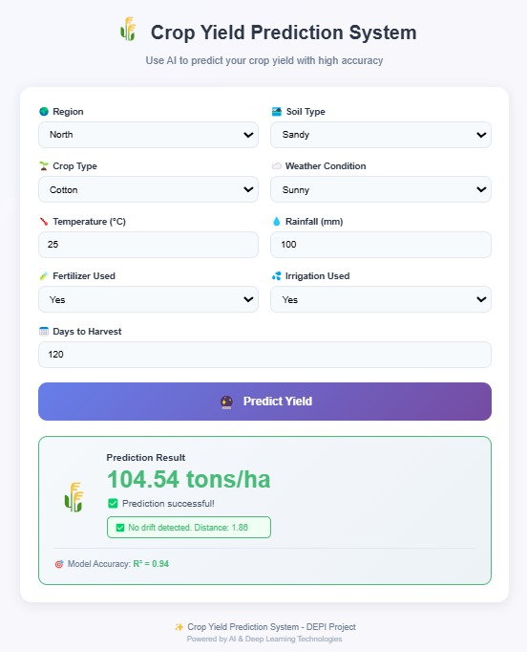
Primary User Farmers, Agribusinesses, and Government Consultants focused on food security. Live Monitoring Performance tracking and drift detection to maintain model reliability over time. Web Interface User-friendly Flask-based dashboard for instant result visualization and input forms.
Ecosystem & Capabilities

Slide 10
Stakeholders & Capabilities
Smallholder Farmers
Empowering local growers with data-driven planting decisions and yield forecasting.
Key Features
Real-time Yield Prediction, Performance Drift Monitoring, and Interactive Dashboard
Agri-Agencies
Government and consultants cab use aggregated data for regional food security planning.

Slide 11
Data Architecture
S
Category
Description
Dataset
Crop_yield.csv (10.000+Records. 9 Features)
Features
Region, Soil Type, Weather, Temp, Rainfall, Fertilizer, Irrigation, Days
Preprocessing
Label Encoding, StandardScaler for normalization
Advanced Tech
XGBoost optimized noise detection for robust modeling

Slide 12
Technology Ecosystem
ML Frameworks
TensorFlow, Scikit-learn, XGBoost, Pandas, NumPy.
Web Engine
Flask (Backend), JobLib (Model Persistence).
Core Stack
Python, JavaScript,
HTML5, CSS3.

Slide 13
Production Status
Deployment & Validation
94.27%
R² Accuracy Score
Deployment: Production ready Testing: Unit, Integration, UAT Passed RMSE: 0.4001 (Minimal Error).

Slide 14
Project Output
Final Product
A fully integrated end-to-end AI system capable of transforming raw environmental data into actionable agricultural intelligence.
Documentation & Code
Technical Report & User Manual.
Model Registry (models/) & Notebooks.
Flask Web Application (app.py)
Timeline: 5 milestones are completed

Slide 15




Shahd Mostafa Farouk Project lead & AI Architect ID: 21120155
Mohamed Ahmed Mohamed Data Systems Engineer ID: 21088856
Ebrahim Ashraf Ebrahim Backend Developer ID: 21120317
Eman Saber Ibrahim QA Specialist ID: 21125954
Powered by Digital Egypt Pioneers Initiative (DEPI)

Slide 16
Thank you
Future-Proofing Agriculture Through AI

